Slide 1
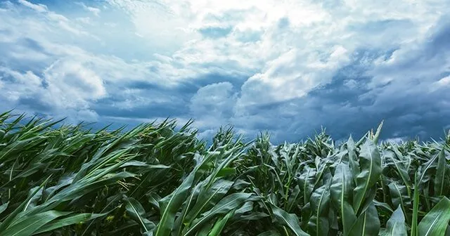
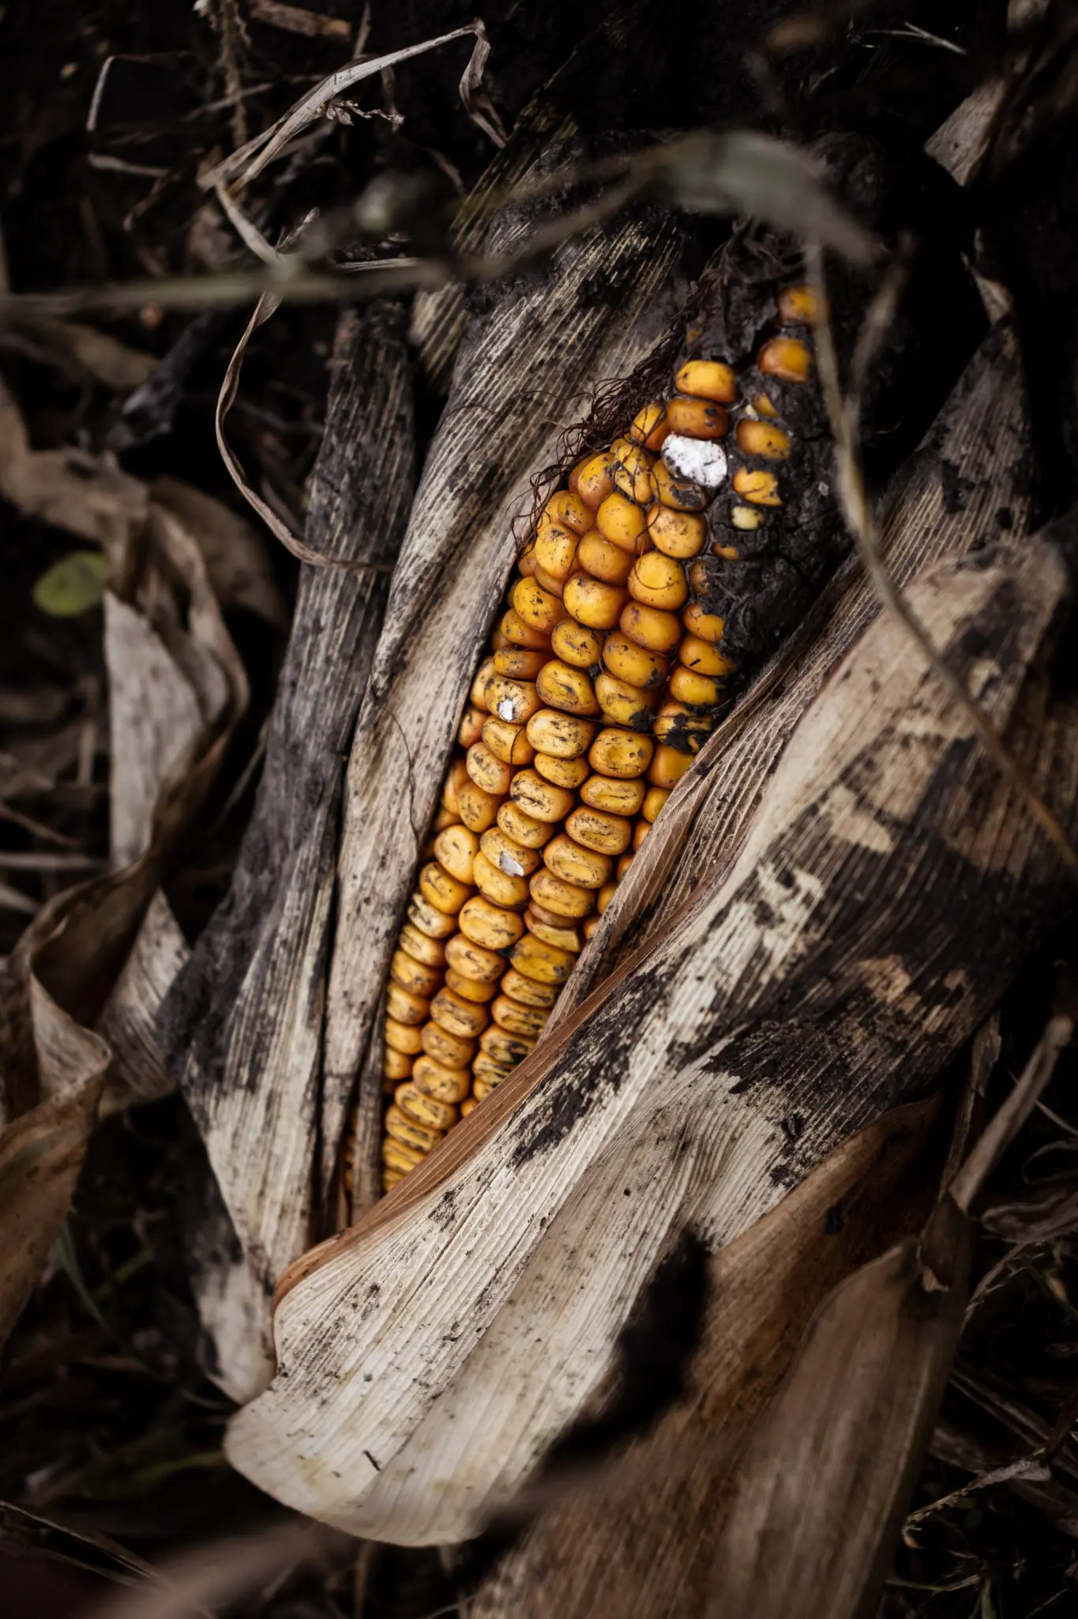
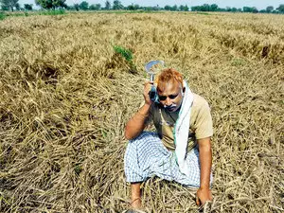


Slide 2
AccuAlert is an application designed to help all Farmers in the process of crop cultivation
One of the biggest problem that all Farmers face is the unpredictable harsh weather, being the main reason for investing too much money in the wrong package of insurance .

Slide 3
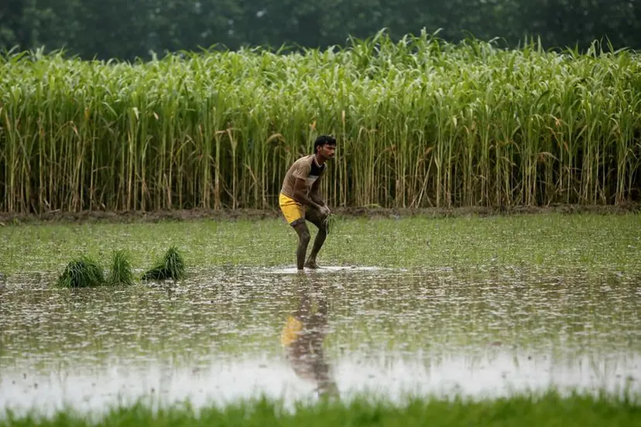

AccuAlert is an application designed to help all Farmers in the process of crop cultivation
Weather Hazards: The app identifies potential weather hazards such as drought, flooding and freezing.
One of the biggest problem that all Farmers face is the unpredictable harsh weather, being the main reason for investing too much money in the wrong package of insurance .
Weather Forecasts: The web application provides detailed weather forecasts for a period of up to 30 days.
Crop recommendations: The app provides crop recommendations based on the weather forecast and local conditions.

Slide 4
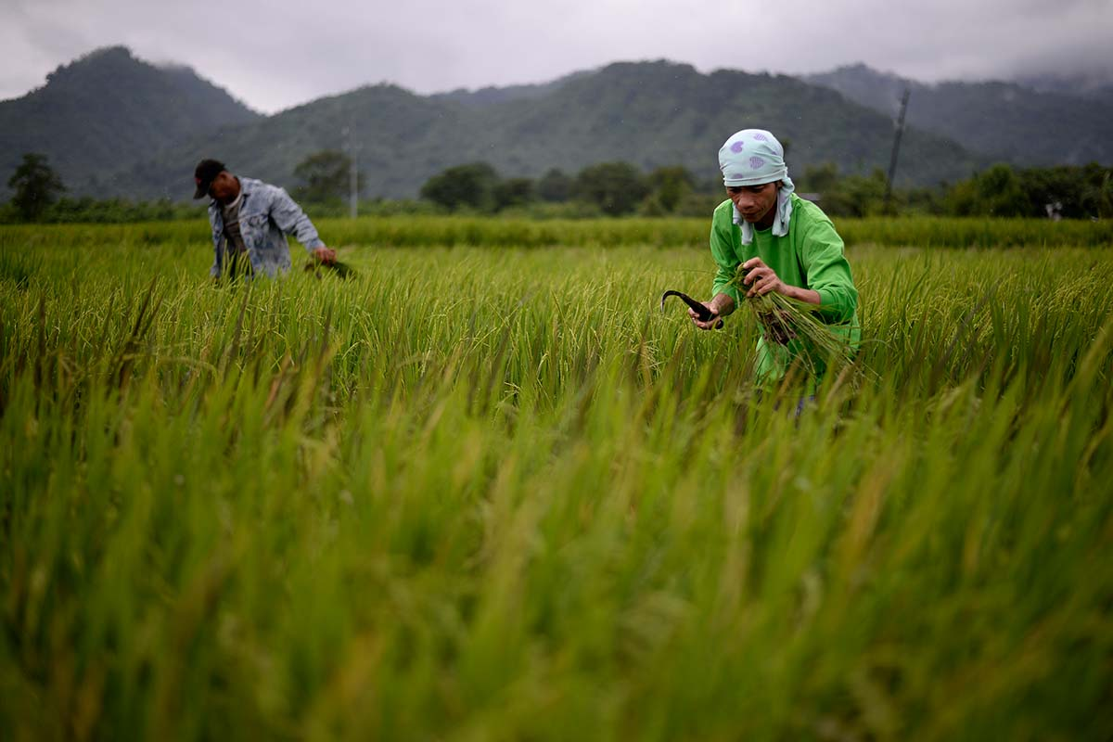
AccuAlert is an application designed to help all Farmers in the process of crop cultivation
Weather Hazards: The app identifies potential weather hazards such as drought, flooding and freezing.
One of the biggest problem that all Farmers face is the unpredictable harsh weather, being the main reason for investing too much money in the wrong package of insurance .
Weather Forecasts: The web application provides detailed weather forecasts for a period of up to 30 days.
Crop recommendations: The app provides crop recommendations based on the weather forecast and local conditions.
Crop yield = 100 bushels per acre
Crop price = €10 per bushel Insurance premium = €1000 per year
Risk of crop failure = 0.2 Subsidy for agricultural insurance = 50%
Expected loss from crop failure = 100 bushels per acre * €10 per bushel * 0.2 = €200 per acre
Cost of the app = €100 per year
Subsidy for agricultural insurance = €1000 per year * 50% = €500 per year
Savings = €200 per acre - €100 per year - €500 per year = €600 per acre

Slide 5


Common Name | Botanical Name | Native Areas | Bloom Time | Mature Size | Sun Exposure | Soil Type | Water Level | Best Temperature °C | Harmful Temperature °C | Soil pH
Corn | Zea mays | Central and South America | July-August | 2-3 m | Full sun | Well-drained, sandy loam | 5-10% | 22-27 | <10 and >35 | 6.0-7.5
Rice | Oryza sativa | Southeast Asia | July-September | 0.5-1.5 m | Full sun or partial shade | Flooded | 30-40% | 25-30 | <10 and >40 | 5.5-7.0
Wheat | Triticum aestivum | Fertile Crescent | May-June | 0.7-1.2 m | Full sun | Well-drained, loamy soil | 20-30% | 18-24 | <10 and >35 | 6.0-7.5
Soybean | Glycine max | East Asia | June-August | 0.5-1.5 m | Full sun | Well-drained, loamy soil | 20-30% | 20-28 | <10 and >35 | 6.0-7.5
Weather Hazards: The app identifies potential weather hazards such as drought, flooding and freezing.
Weather Forecasts: The web application provides detailed weather forecasts for a period of up to 30 days.
Weather Forecasts: The web application provides detailed weather forecasts for a period of up to 30 days.
Crop recommendations: The app provides crop recommendations based on the weather forecast and local conditions.
Weather Hazards: The app identifies potential weather hazards such as drought, flooding and freezing.
AccuAlert is an application designed to help all Farmers in the process of crop cultivation
Crop yield = 100 bushels per acre
Crop price = €10 per bushel Insurance premium = €1000 per year
Risk of crop failure = 0.2 Subsidy for agricultural insurance = 50%
Expected loss from crop failure = 100 bushels per acre * €10 per bushel * 0.2 = €200 per acre
Cost of the app = €100 per year
Subsidy for agricultural insurance = €1000 per year * 50% = €500 per year
Savings = €200 per acre - €100 per year - €500 per year = €600 per acre
One of the biggest problem that all Farmers face is the unpredictable harsh weather, being the main reason for investing too much money in the wrong package of insurance .

Slide 6
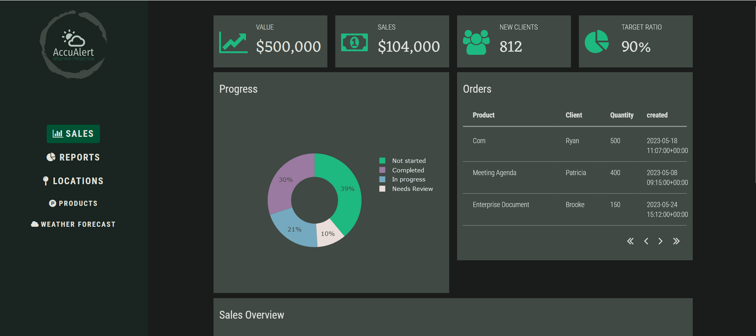
Crop yield = 100 bushels per acre
Crop price = €10 per bushel Insurance premium = €1000 per year
Risk of crop failure = 0.2 Subsidy for agricultural insurance = 50%
Expected loss from crop failure = 100 bushels per acre * €10 per bushel * 0.2 = €200 per acre
Cost of the app = €100 per year
Subsidy for agricultural insurance = €1000 per year * 50% = €500 per year
Savings = €200 per acre - €100 per year - €500 per year = €600 per acre
Weather Hazards: The app identifies potential weather hazards such as drought, flooding and freezing.
Weather Forecasts: The web application provides detailed weather forecasts for a period of up to 30 days.
Weather Forecasts: The web application provides detailed weather forecasts for a period of up to 30 days.
Crop recommendations: The app provides crop recommendations based on the weather forecast and local conditions.
Weather Hazards: The app identifies potential weather hazards such as drought, flooding and freezing.
AccuAlert is an application designed to help all Farmers in the process of crop cultivation
Common Name | Botanical Name | Native Areas | Bloom Time | Mature Size | Sun Exposure | Soil Type | Water Level | Best Temperature °C | Harmful Temperature °C | Soil pH
Corn | Zea mays | Central and South America | July-August | 2-3 m | Full sun | Well-drained, sandy loam | 5-10% | 22-27 | <10 and >35 | 6.0-7.5
Rice | Oryza sativa | Southeast Asia | July-September | 0.5-1.5 m | Full sun or partial shade | Flooded | 30-40% | 25-30 | <10 and >40 | 5.5-7.0
Wheat | Triticum aestivum | Fertile Crescent | May-June | 0.7-1.2 m | Full sun | Well-drained, loamy soil | 20-30% | 18-24 | <10 and >35 | 6.0-7.5
Soybean | Glycine max | East Asia | June-August | 0.5-1.5 m | Full sun | Well-drained, loamy soil | 20-30% | 20-28 | <10 and >35 | 6.0-7.5
One of the biggest problem that all Farmers face is the unpredictable harsh weather, being the main reason for investing too much money in the wrong package of insurance .

Slide 7
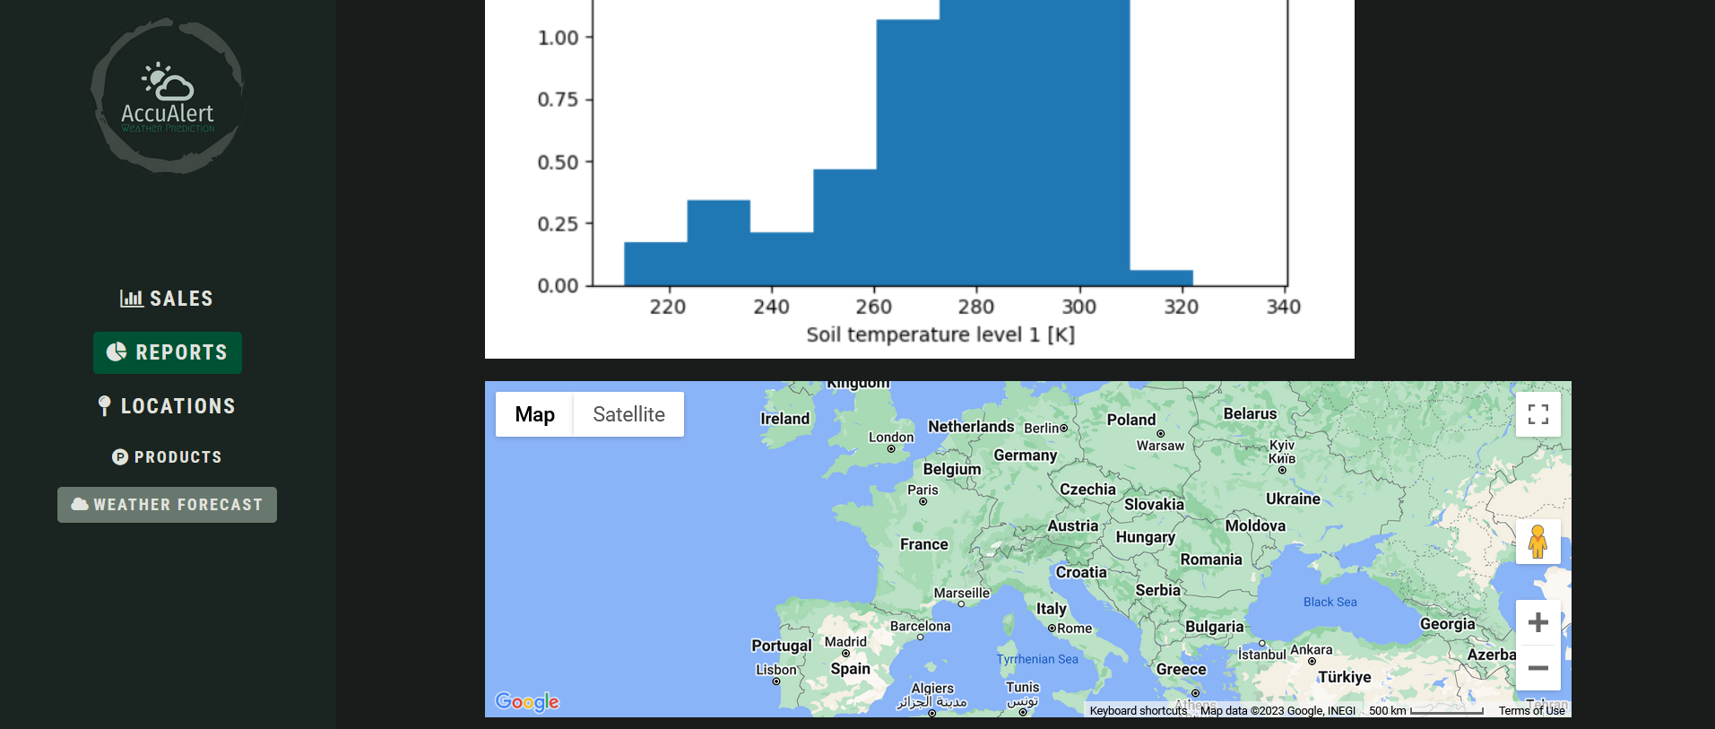
Crop yield = 100 bushels per acre
Crop price = €10 per bushel Insurance premium = €1000 per year
Risk of crop failure = 0.2 Subsidy for agricultural insurance = 50%
Expected loss from crop failure = 100 bushels per acre * €10 per bushel * 0.2 = €200 per acre
Cost of the app = €100 per year
Subsidy for agricultural insurance = €1000 per year * 50% = €500 per year
Savings = €200 per acre - €100 per year - €500 per year = €600 per acre
Weather Hazards: The app identifies potential weather hazards such as drought, flooding and freezing.
Weather Forecasts: The web application provides detailed weather forecasts for a period of up to 30 days.
Weather Forecasts: The web application provides detailed weather forecasts for a period of up to 30 days.
Crop recommendations: The app provides crop recommendations based on the weather forecast and local conditions.
Weather Hazards: The app identifies potential weather hazards such as drought, flooding and freezing.
AccuAlert is an application designed to help all Farmers in the process of crop cultivation
One of the biggest problem that all Farmers face is the unpredictable harsh weather, being the main reason for investing too much money in the wrong package of insurance .
Common Name | Botanical Name | Native Areas | Bloom Time | Mature Size | Sun Exposure | Soil Type | Water Level | Best Temperature °C | Harmful Temperature °C | Soil pH
Corn | Zea mays | Central and South America | July-August | 2-3 m | Full sun | Well-drained, sandy loam | 5-10% | 22-27 | <10 and >35 | 6.0-7.5
Rice | Oryza sativa | Southeast Asia | July-September | 0.5-1.5 m | Full sun or partial shade | Flooded | 30-40% | 25-30 | <10 and >40 | 5.5-7.0
Wheat | Triticum aestivum | Fertile Crescent | May-June | 0.7-1.2 m | Full sun | Well-drained, loamy soil | 20-30% | 18-24 | <10 and >35 | 6.0-7.5
Soybean | Glycine max | East Asia | June-August | 0.5-1.5 m | Full sun | Well-drained, loamy soil | 20-30% | 20-28 | <10 and >35 | 6.0-7.5

Slide 8

Crop yield = 100 bushels per acre
Crop price = €10 per bushel Insurance premium = €1000 per year
Risk of crop failure = 0.2 Subsidy for agricultural insurance = 50%
Expected loss from crop failure = 100 bushels per acre * €10 per bushel * 0.2 = €200 per acre
Cost of the app = €100 per year
Subsidy for agricultural insurance = €1000 per year * 50% = €500 per year
Savings = €200 per acre - €100 per year - €500 per year = €600 per acre
Weather Hazards: The app identifies potential weather hazards such as drought, flooding and freezing.
Weather Forecasts: The web application provides detailed weather forecasts for a period of up to 30 days.
Weather Forecasts: The web application provides detailed weather forecasts for a period of up to 30 days.
Crop recommendations: The app provides crop recommendations based on the weather forecast and local conditions.
Weather Hazards: The app identifies potential weather hazards such as drought, flooding and freezing.
AccuAlert is an application designed to help all Farmers in the process of crop cultivation
One of the biggest problem that all Farmers face is the unpredictable harsh weather, being the main reason for investing too much money in the wrong package of insurance .
Common Name | Botanical Name | Native Areas | Bloom Time | Mature Size | Sun Exposure | Soil Type | Water Level | Best Temperature °C | Harmful Temperature °C | Soil pH
Corn | Zea mays | Central and South America | July-August | 2-3 m | Full sun | Well-drained, sandy loam | 5-10% | 22-27 | <10 and >35 | 6.0-7.5
Rice | Oryza sativa | Southeast Asia | July-September | 0.5-1.5 m | Full sun or partial shade | Flooded | 30-40% | 25-30 | <10 and >40 | 5.5-7.0
Wheat | Triticum aestivum | Fertile Crescent | May-June | 0.7-1.2 m | Full sun | Well-drained, loamy soil | 20-30% | 18-24 | <10 and >35 | 6.0-7.5
Soybean | Glycine max | East Asia | June-August | 0.5-1.5 m | Full sun | Well-drained, loamy soil | 20-30% | 20-28 | <10 and >35 | 6.0-7.5

Slide 9
Crop yield = 100 bushels per acre
Crop price = €10 per bushel Insurance premium = €1000 per year
Risk of crop failure = 0.2 Subsidy for agricultural insurance = 50%
Expected loss from crop failure = 100 bushels per acre * €10 per bushel * 0.2 = €200 per acre
Cost of the app = €100 per year
Subsidy for agricultural insurance = €1000 per year * 50% = €500 per year
Savings = €200 per acre - €100 per year - €500 per year = €600 per acre
Weather Hazards: The app identifies potential weather hazards such as drought, flooding and freezing.
Weather Forecasts: The web application provides detailed weather forecasts for a period of up to 30 days.
Weather Forecasts: The web application provides detailed weather forecasts for a period of up to 30 days.
Crop recommendations: The app provides crop recommendations based on the weather forecast and local conditions.
Weather Hazards: The app identifies potential weather hazards such as drought, flooding and freezing.
AccuAlert is an application designed to help all Farmers in the process of crop cultivation
Tanasa Stefan Alexandru
Tanasa Stefan Alexandru
One of the biggest problem that all Farmers face is the unpredictable harsh weather, being the main reason for investing too much money in the wrong package of insurance .
NatureLaws
Lungu Ioan Stelian
Maghiar Alexandra
Lungu Gabriel Dimitrie
Tanasa Stefan Alexandru
Common Name | Botanical Name | Native Areas | Bloom Time | Mature Size | Sun Exposure | Soil Type | Water Level | Best Temperature °C | Harmful Temperature °C | Soil pH
Corn | Zea mays | Central and South America | July-August | 2-3 m | Full sun | Well-drained, sandy loam | 5-10% | 22-27 | <10 and >35 | 6.0-7.5
Rice | Oryza sativa | Southeast Asia | July-September | 0.5-1.5 m | Full sun or partial shade | Flooded | 30-40% | 25-30 | <10 and >40 | 5.5-7.0
Wheat | Triticum aestivum | Fertile Crescent | May-June | 0.7-1.2 m | Full sun | Well-drained, loamy soil | 20-30% | 18-24 | <10 and >35 | 6.0-7.5
Soybean | Glycine max | East Asia | June-August | 0.5-1.5 m | Full sun | Well-drained, loamy soil | 20-30% | 20-28 | <10 and >35 | 6.0-7.5

